Slide 1
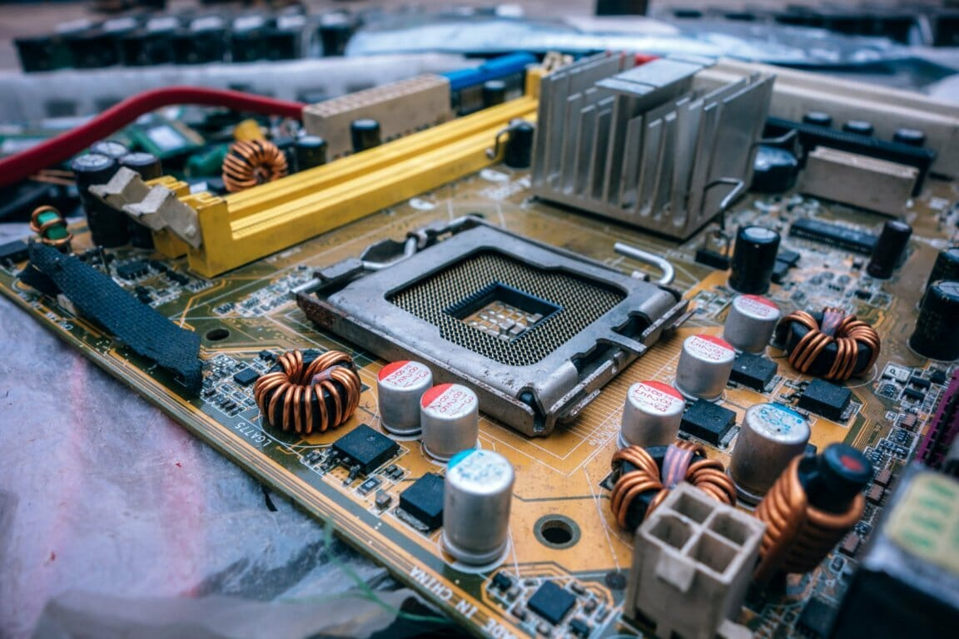
Computer System Development in Recent Years: A Q&A Exploration
Unveiling the Trends and Innovations Shaping Our Digital Landscape
Name:- Satkunananthan Piragenth
Reg No:- SEU/IS/22/ICT/075

Slide 2

Key Trends Driving System Development
Cloud Computing :- Flexible resource use, Scalable infrastructure
Artificial Intelligence :- Automation, improved decision-making, personalization
Internet of Things (IOT) :- Growing device networks, complex data flows
Edge Computing & Cybersecurity : Real-time processing, security-first development

Slide 3
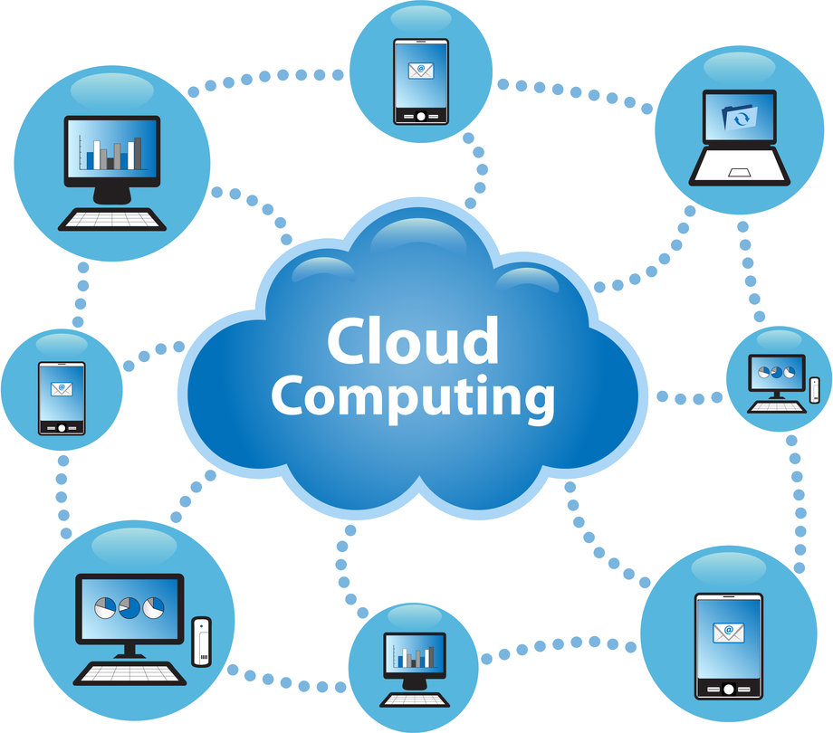
Cloud Computing Revolution
Scalability :- Instantly handle growing demands
Flexibility:- Access resources anytime, anywhere
Cost Efficiency :- Pay as you go models reduce expenses
Further Learning :- Watch Cloud Computing Explained
This Photo by Unknown Author is licensed under CC BY-NC

Slide 4


Artifical Intelligence Impact
This Photo by Unknown Author is licensed under CC BY-SA-NC
This Photo by Unknown Author is licensed under CC BY-SA
Computer Vision
Natural Language Processing
Empowers recognition and analysis of images
Algorithms learn and adapt autonomously
Enhances communication with systems

Slide 5




Internet of things (IoT)
Data Challenges
Handling vast diverse data streams
Scalability Needs
System architectures must grow efficiently
Expanding Networks
Millions of devices communicate constanly
Security Rists
Protecting connected device vulnerabilites

Slide 6
Edge Computing Explained
Data Collection :- Sensors and devices gather information
Local Processing :- Data processed close to the source
Reduced Latency :- Faster responses for real-time apps
Cloud Sync :- Processed data sent to cloud for storage

Slide 7
Cybersecurity in Development
Code Security :- Implement secure coding practices.
Data Encryption :- Protect Sensitive data at rest and transit.
Threat Monitoring :- Detect and respond to emerging attacks
Proactive Defense :- Adopt continuous security improvemtents

Slide 8
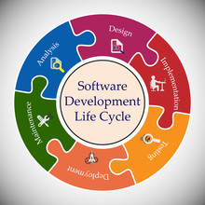
THE FUTURE OF SYSTEM DEVELOPMENT
Trend Summary :- Cloud, AI, IoT, Edge, Security evolve rapidly
Emerging Tech :- Quantum computing, blockchain, and more
Call to Action :- Prepare for continuous innovation and adaptation

